Slide 1
IOT BASED DOOR LOCK
SYSTEM
Submitted by-
Divya sree (16BD1A0491)
Srividya joshi (16BD1A0499)
Srihari (16BD1A0492)

Slide 2
INTRODUCTION
Electronic door locks are a way to replace keys or to add additional automation for homes and businesses.
Automation provides an extra layer of convenience and safety for the user, but may also provide additional functionality as well.
Coming to our project, Password Based Door Lock System is designed using ARDUINO UNO where in once the correct code or password is entered, the door is open, and the concerned person is allowed access to the secured area.

Slide 3
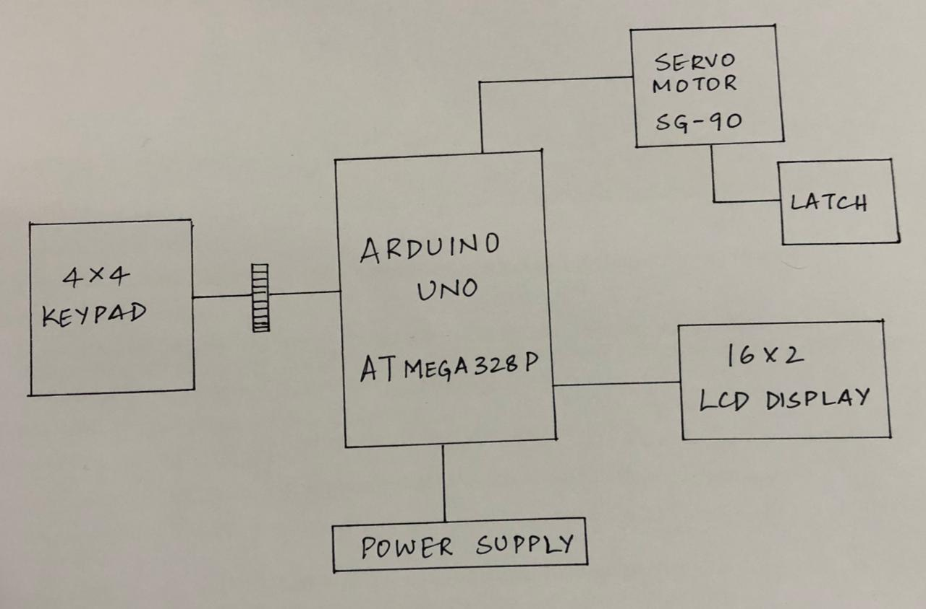
BLOCK DIAGRAM OF ELECRONIC DOOR LOCKING SYSTEM

Slide 4
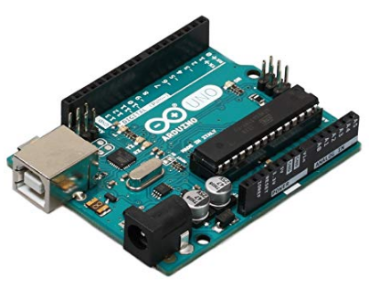
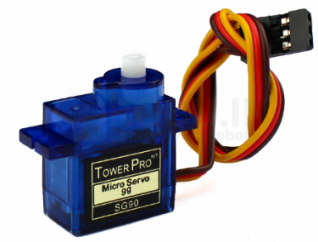
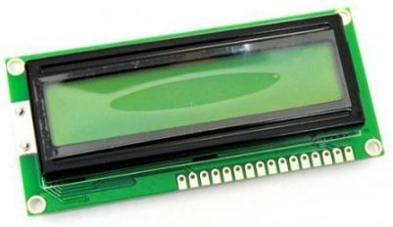
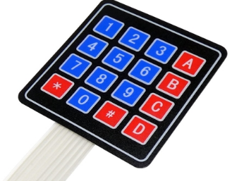
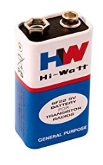
Components required for this project
Arduino UNO
16x2 lcd
Servo motor
4x4 keypad
Power supply

Slide 5
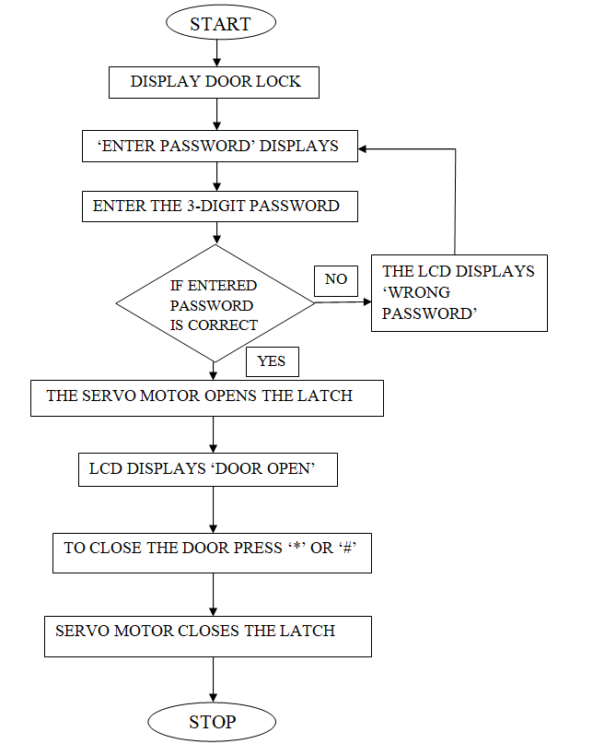
.
WORKING:
Algorithm

Slide 6
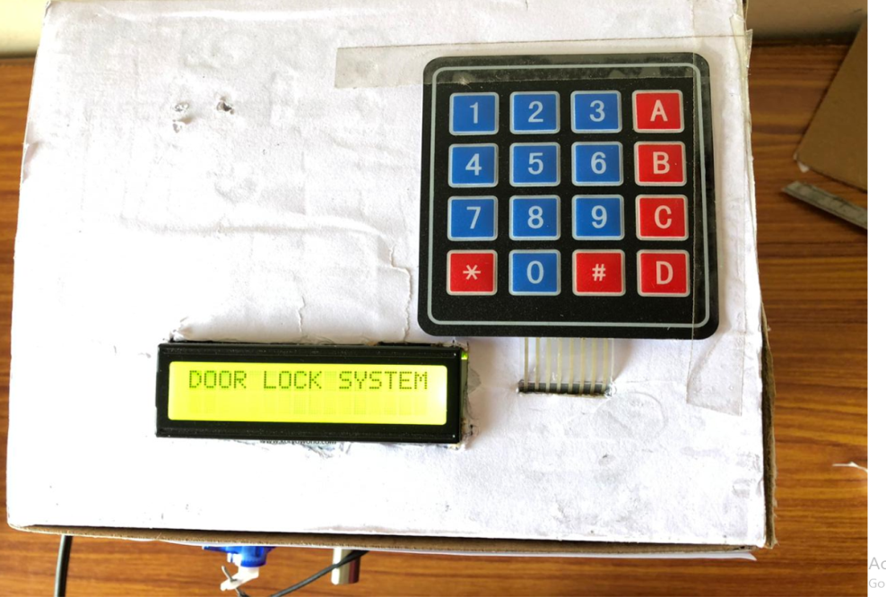
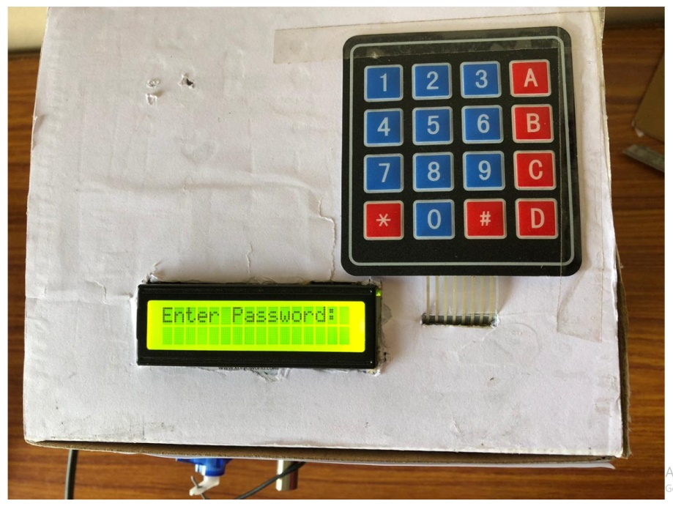
.
Working of electronic door locking system can be explained by following steps
Step 1: When power supply is given to the arduino, LCD displays “DOOR LOCKING SYSTEM” and after few seconds it displays “ENTER PASSWORD” enabling user to enter the password.

Slide 7
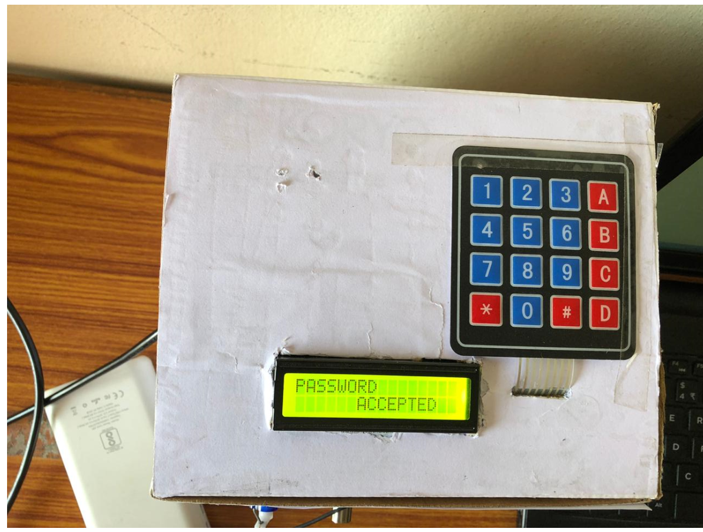
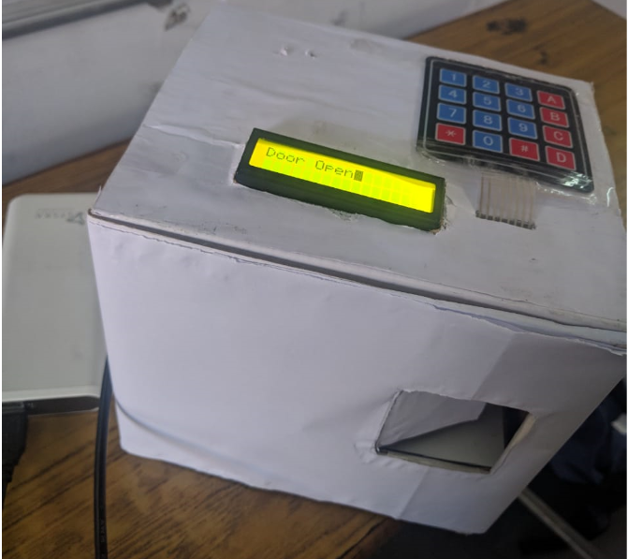
.
Step 2: Enter the predefined password with the help of 4x4 keypad . If the password entered matches with the predefined password LCD displays “Password Accepted”. Then, the servo motor gets unlocked, LCD displays “Door open” and the door opens.

Slide 8
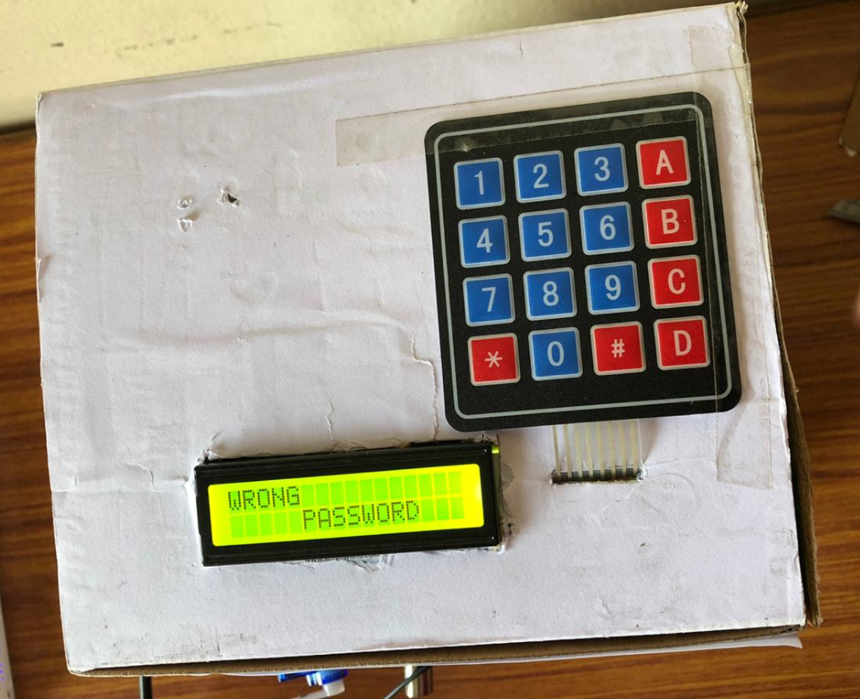
.
Step 3: If the password entered doesn’t match with the predefined password LCD displays “Wrong Password”.

Slide 9
MERITS
This project provides security
Power consumption is less
Used commonly available components
Project is simple and easy
DEMERITS
It is a low range circuit, i.e. it is not possible to operate the circuit remotely.
If you forget the password it is not possible to open the door.

Slide 10
FUTURE SCOPE
The security level can be increased by adding a biometric fingerprint scanner. We can interface sensors like Fire, LPG, PIR motion detector to microcontroller in case of any accident so that door will open automatically.
We can interface camera to the micro controller so that it could capture the picture of the thief who is trying to breach the security.
The electronic lock can be integrated into any complex security system, used in conjunction with alarms, video surveillance cameras, and other elements.

Slide 11
CONCLUSION
This project is effective in providing enough security as long as the password is not shared. In future this “Arduino based password security locking system” can be provided maximum security by few enhancements in order to completely satisfy user’s needs. Hence, a common man can afford to purchase such locking system in minimal cost to keep his valuables safely without any worries.

Slide 12
THANKYOU
.

